Slide 1
Writing, Critical Thinking, and Argument Diagrams

Slide 2
Recall our big goal
Learn how to use writing to explore new worlds
  Here: Science and Religion in the Western Tradition
Why explore?
I-80 metaphor
What do you need before you can explore (with that purpose)?
Notes:
Explore to understand.
Things associated with understanding: predicting, explaining, advising, reproducing, learning, evaluating

Slide 3
Why we’re reading and writing
Our goal is to understand some aspect of the history of science and religion in the Western tradition
We can think of what we’re doing in this class as aiming at that:
Reading to write → writing to think → thinking to understand

Slide 4
Why we’re reading and writing
Our goal is to understand some aspect of the history of science and religion in the Western tradition
We can think of what we’re doing in this class as aiming at that:
Reading to write → writing to think → thinking to understand

Slide 5
What is critical thinking?
Knowledge of components of critical thinking, such as logic, language, and argumentation
Skill: The ability to put those components of critical thinking to use in real-world situations
Dispositions: The personal characteristics needed to prioritize reasoning over other ways of learning or making decisions, the willingness and readiness to put the tools of critical thinking to use, and the commitment to use one’s critical-thinking ability honestly and ethically
Haber, Critical Thinking (2020)

Slide 6
Recall our specific goals
Intellectual Virtues: Understand doubt and confusion as an opportunity for growth and self-generated curiosity.
Critical Thinking: Learn how to use writing as a tool for sustaining curiosity and holding our judgmental thinking accountable.
Research Skills: Develop the research skills necessary for determining whether historical texts will shed light on a research question, and, if so, for identifying which historical texts should be investigated. Likewise for parts of historical texts.
Appreciation for Historiography: Appreciate the insidiousness of anachronism and other historical biases, and cultivate basic methods for minimizing them.

Slide 7
Statements
A sentence that can be true or false.
Which are statements?
  Ouch!
  When is class over?
  I’m learning critical thinking in a history class.
  God does not exist.

Slide 8
Conditional statements
If X, then Y
  Example: If I go to the movies, I’ll buy you popcorn.
  X is antecedent, Y is consequent
  This is the standard form
  Equivalent forms:
    Y if X
    X only if Y
Put these in standard form:
  You get an A in this class only if you get an A on the paper.
  Religion is Western if it doesn’t exist outside of the West.
  Aristotle is a scientist only if ancient Greeks can be scientists.

Slide 9
Arguments
Arguments are sets of statements where:
  one is the conclusion,
  the rest are premises,
  and the premises provide support for the conclusion.
Example:
  If something is evil, it should be banned. (premise 1)
  Geese are evil. (premise 2)
  Geese should be banned. (conclusion)

Slide 10
Kinds of arguments
An argument is valid if it is not possible for the conclusion to be false if the premises are true.
  Previous argument
An argument is invalid if it is possible for the conclusion to be false when the premises are true.
Is this valid or invalid?
  If tomatoes are a vegetable, then the Earth is flat.
  The Earth is flat.
  Tomatoes are a vegetable.

Slide 11
Kinds of arguments, cont.
An argument is sound if it is valid and its premises are true.
  If Biden is the president, then he lives in the White House.
  Biden is the president.
  Biden lives in the White House.
Not all invalid arguments are bad!
  Some are stronger than others (see below)
  An argument is strong if its conclusion is more likely given premises.
  An argument is cogent if it is strong and has true premises.
10% of NWU students have COVID.
I am an NWU student.
I have COVID.
90% of NWU students have COVID.
I am an NWU student.
I have COVID.

Slide 12
Necessary and sufficient conditions
X is a necessary condition for Y: If Y, then X
  Informal: Y cannot occur without X
Z is a sufficient condition for Y: If Z, then Y
  Informal: Z is enough for Y (although could maybe get Y some other way)
Examples
  Getting an A on your paper is a ?? condition for getting an A in the class.
  More points in regulation is a ?? condition for winning a basketball game.
  Living in Nebraska is a ?? condition for being a good person.

Slide 13
Deductive argument forms
An argument is deductive if it is intended to be valid.
  “CON” stands for “contradiction”
Modus Ponens | Modus Tollens | Hypothetical Syllogism | Disjunctive Syllogism | Constructive Dilemma | Categorial Syllogism | Reductio ad absurdum
If A, then B. A. B. | If A, then B. Not B. Not A. | If A, then B. If B, then C. If A, then C. | Either A or B. Not A. B. | Either A or B. If A, then C. If B, then D. Either C or D. | All As are Bs. C is an A. C is a B. | Assume A. If A, then CON. Not A.

Slide 14
Non-deductive argument forms
An argument is non-deductive if it is intended to be strong.
Induction
  based on observations so far
Analogy
  Use true things about another, analogous situation to argue for truth in case at hand
Abduction
  Explanation is true because it’s the best one we have

Slide 15
Exercises
2.8, 1—6 (pages 30—32)
For 6, only do up to L (skip m through s)

Slide 16
What’s the point?
What’s the point of all of this again?
How helpful are our tools so far for longer arguments?
  Recall: what tools do we have so far?

Slide 17
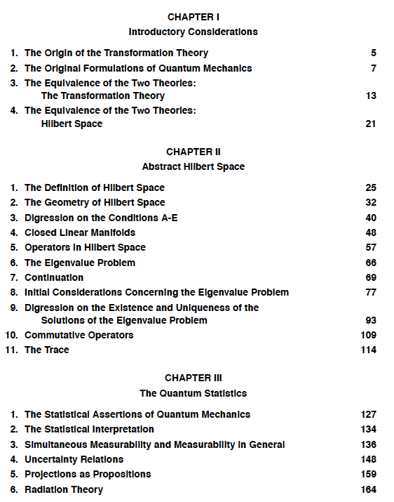
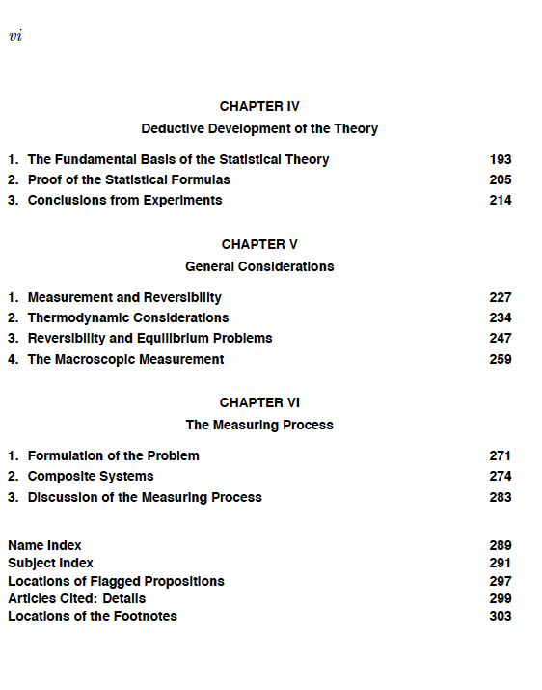

Example from my own writing

Slide 18
What we can do so far
Page 34: long argument
Can simplify some with tools we already have:
  Alexis should study for her math quiz.
  Alexis should go to bed early.
  Alexis should not spend money on a concert ticket.
  Alexis should not go to the concert.
But this is still a lot to read, and doesn’t make the connections transparent

Slide 19
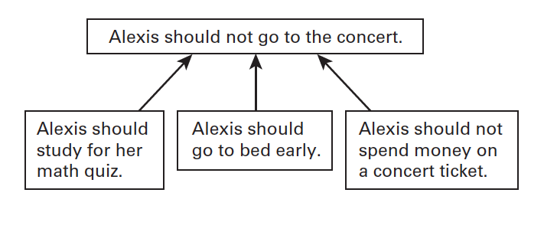
Visualizing (convergent)
Conclusion
beginning “supports” end
Premises

Slide 20
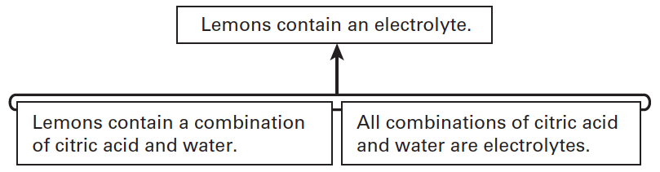
A different kind of argument (linked)
Pages 36 and 37: another long-ish argument
  Lemons contain a combination of citric acid and water.
  All combinations of citric acid and water are electrolytes.
  Lemons contain an electrolyte

Slide 21
Rules
Each box contains only one statement.
The arrows begin at one box, or one grouping of boxes, and end at one box.
The box at the end of the arrow is the conclusion of the argument.
The box(es) at the beginning of the arrow is (are) the premise(s).
The arrow is the inference from premise(s) to conclusion.
Separate arrows indicate separate lines of reasoning (the inferences).
Attached boxes indicate that the premises are supposed to work together to support the conclusion.

Slide 22
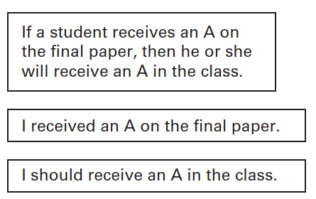
Practice (note: not true of our class!)

Slide 23
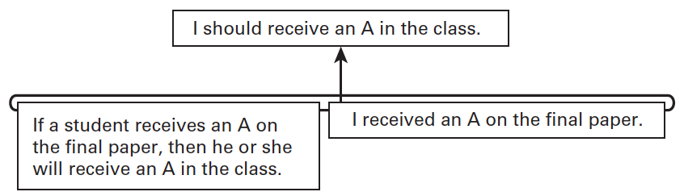
Practice answer (linked argument)

Slide 24
Representation is interpretation
Arguments have to be interpreted to be represented
  In general, this can be done in many ways
  But, some ways are better than others
  Well-written arguments tell us how to interpret them (more or less)
Astronomy was like a science because it made reliable predictions.
  Any clues here?

Slide 25
Indicators
Premise indicators
  Because
  Since
  Consider that
  For
  As
  After all
  Given that
  Recall that
  It is evident that
  The reason is that
  Assuming that
  Based on the fact that
Conclusion indicators
  So
  Thus
  Hence
  Therefore
  Accordingly
  Consequently
  We may infer that
  Implies that
  Shows that
  Wherefore
  Proves that
  It follows that

Slide 26
More indicators
Combination (linked premises)
  And
  But
  Thus, since
  So, because
  Besides
  As well as
  In addition to the fact that
  Plus the fact that
Convergent
  Besides
  Furthermore
  Also
  Another reason
  Moreover
  Furthermore

Slide 27
One last basic kind of argument
Since astronomy wasn’t a science before 1572, science didn’t exist. So, science was invented after 1572.
  Any indicators?

Slide 28
Chain argument
Science was invented after 1572.
Science did not exist.
Astronomy wasn’t a science before 1572.

Slide 29
Note on diagrams in rest of course
We are introducing these as a tool for understanding arguments
  Research suggests they are a more helpful way of summarizing arguments for the purposes of critically engaging with them
  It’s okay if you don’t use them, but I ask you try them out for a bit first
  Will have other options for engaging with readings going forward

Slide 30
Fairness and charity
Fairness
  Interpret in a way consistent with the author’s intentions
  Try to use their language, and try not to put words in their mouth
Charity
  If there is uncertainty, try to show the argument in the best possible light
  If there is ambiguity, choose the interpretation that makes the argument stronger
Tl;dr, give the author the benefit of the doubt
  Caveat: unless there is good reason to believe they are acting in bad faith

Slide 31
Implicit premises and conclusions
Sometimes, premises or conclusions are implied, but not explicitly stated
And sometimes, arguments are just incomplete
In these cases, we need to supplement the argument
  We will talk about how to do this as we go

Slide 32
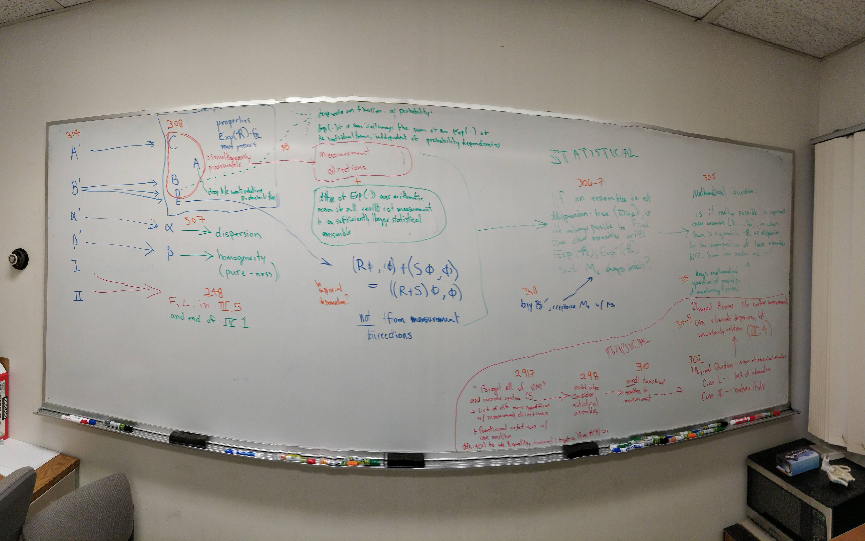
Example from my writing, part 2

Slide 33
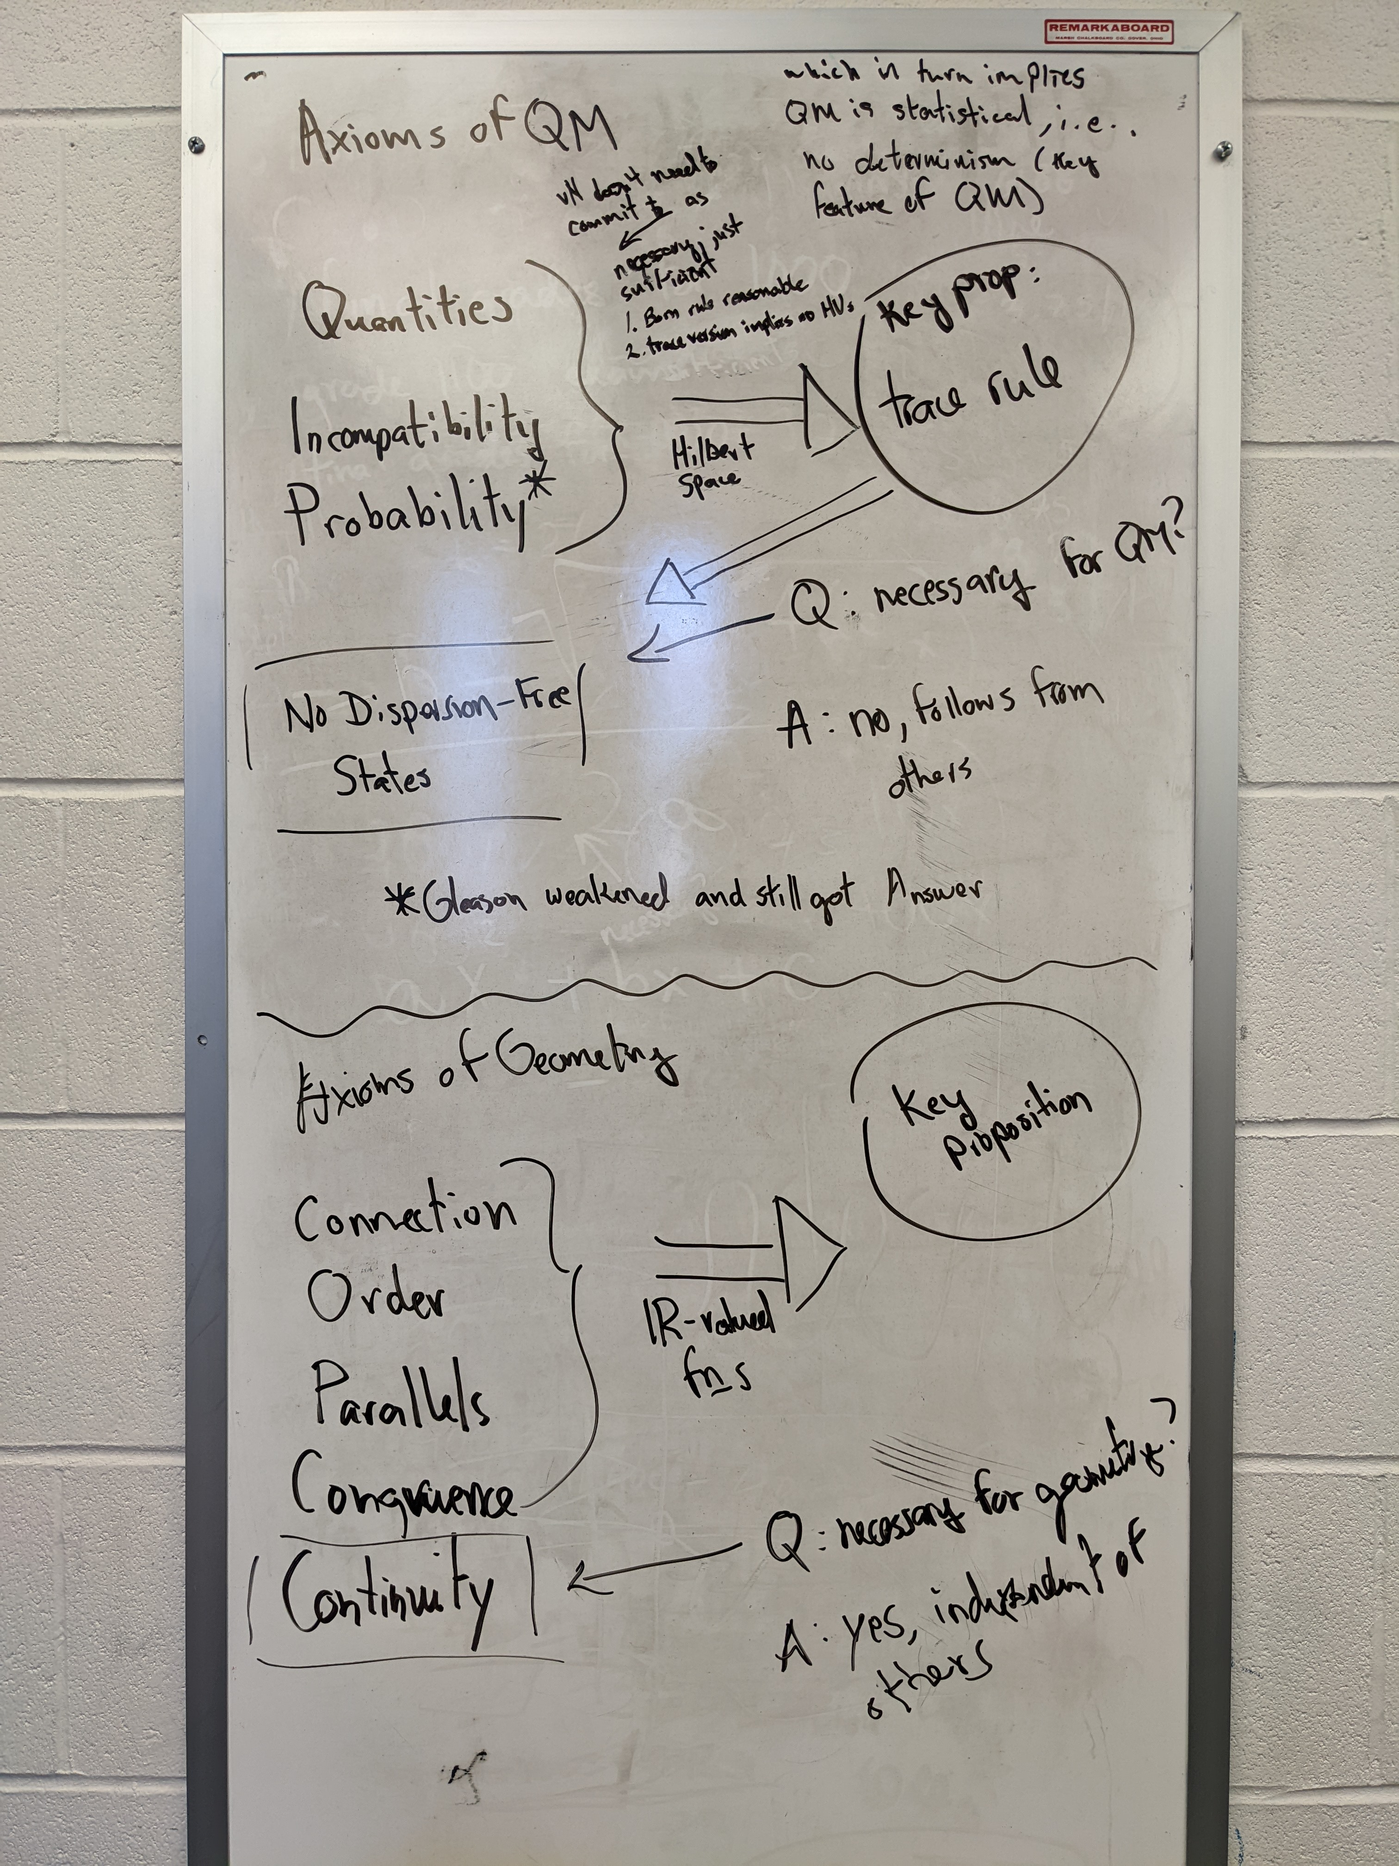
Example from my own writing, part 3

Slide 34
Yalcinkaya, “The ‘Harmony Thesis’ in the Turkish Media, 1950—1970” (140—1)
”Demonstrating that Islam was not in conflict with science was not simply a matter of presenting historical evidence, however. Many authors strived to show that the fundamentals of Islam made it a religion that could only be in harmony with science, commonly using one or both of two particular strategies: First: Highlighting ideas from the Islamic canon that encouraged learning and research…Authors also noted that the rapid spread of Islam after its emergence could only be because its principles were rooted in knowledge, and both the Qur’an and the prophet instructed Muslims to follow and respect scholars.
Second: Introducing selections from the Qur’an and sayings attributed to the prophet that were claimed to be in harmony with scientific discoveries…”

Slide 35
Shapin, The Scientific Revolution (3—4)
“As our understanding of science in the seventeenth century has changed in recent years, so historians have become increasingly uneasy with the very idea of “the Scientific Revolution.” Even the legitimacy of each word making up that phrase has been individually contested. Many historians are now no longer satisfied that there was any singular and discrete event, localized in time and space, that can be pointed to as “the” Scientific Revolution. Such historians now reject even the notion that there was any single coherent cultural entity called “science” in the seventeenth century to undergo revolutionary change. There was, rather, a diverse array of cultural practices aimed at understanding, explaining, and controlling the natural world, each with different characteristics and each experiencing different modes of change. We are now much more dubious of claims that there is anything like “a scientific method”—a coherent, universal, and efficacious set of procedures for making scientific knowledge—and still more skeptical of stories that locate its origin in the seventeenth century, from which time it has been unproblematically passed on to us. And many historians do not now accept that the changes wrought on scientific beliefs and practices during the seventeenth century were as “revolutionary” as has been widely portrayed. The continuity of seventeenth-century natural philosophy with its medieval past is now routinely asserted, while talk of “delayed” eighteenth- and nineteenth-century revolutions in chemistry and biology followed hard upon historians’ identification of “the” Scientific Revolution.”

Slide 36
Homework
Find an argument in the wild about science and religion and diagram it
  Let’s say, at least 4 statements
Two places you could look:
  Principe’s “Science and Religion” lectures
    I have placed a summary of the lectures on Canvas
    You can find these on Audible, Wondrium, or on reserve at the library (DVDs—sorry, best I could do)
  This podcast with Brent Nongbri about his book (we’ll read it later)
  Khan Academy World History series
  Crash Course: World History or History of Science

Slide 37
Wootton, The Invention of Science (xv)
“Modern science was invented between 1572, when Tycho Brahe saw a nova, or new star, and 1704, when Newton published his Opticks, which demonstrated that white light is made up of light of all the colours of the rainbow, that you can split it into its component colours with a prism, and that colour inheres in light, not in objects. There were systems of knowledge we call ’sciences’ before 1572, but the only one which functioned remotely like a modern science, in that it had sophisticated theories based on a substantial body of evidence and could make reliable predictions, was astronomy, and it was astronomy that was transformed in the years after 1572 into the first true science. What made astronomy in the years after 1572 a science? It had a research programme, a community of experts, and it was prepared to question every long-established certainty (that there can be no change in the heavens, that all movement in the heavens is circular, that the heavens consist of crystalline spheres) in the light of new evidence. Where astronomy led, other new sciences followed.”

Slide 38
Plan for 1/28 and next week
Overarching goals
  Practice understanding arguments together
  First steps in:
    Challenging arguments
    Considering ourselves and our intended audience
    Skimming and filling in background knowledge
  Start thinking about topics of interest
Assignments for this section
  4 arguments in Principe (or alternative—come talk)
  4 reading diaries
    How you read
    Interesting thoughts you had: concepts, connections, clashes, strengths/weaknesses
Reading for 1/28: Birken’s “What Is Western Civilization?”

